Slide 1
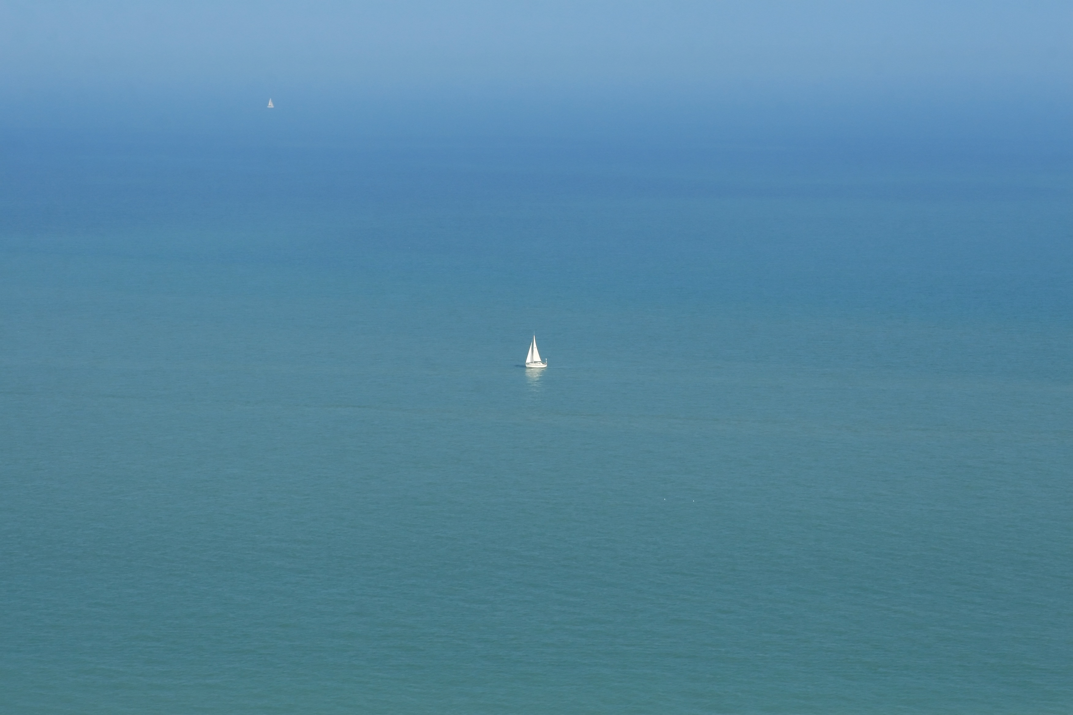
FLOATING POINT
3 14159
A site about sailing and coding

